Slide 1
Amazon Sales Data Analysis Report
Hariom Rajput

Slide 2
Introduction
In today's presentation, we will delve into the comprehensive analysis of Amazon sales data, aiming to extract actionable insights that can drive business growth and optimization.
Objective: To analyze key metrics, trends, and patterns in Amazon sales data to inform strategic decision-making and improve business performance.
Methodology: Our analysis involves data collection, preprocessing, exploratory data analysis, and the derivation of actionable recommendations.

Slide 3
Data Collection and Preparation
Data Sources:
Internal Databases: For historical sales data, transaction records, and customer demographics.
Data Cleaning and Preprocessing:
Removal of duplicates, missing values, and outliers.
Standardization of data formats and units.
Data transformation and feature engineering for improved analysis.

Slide 4
Analytical thinking
Break down
complex problems
Systematic and
logical approach
Cultivate the ability to break down complex problems into several manageable parts
A systematical and logical approach to mathematical problems is the foundation for many disciplines

Slide 5
Display concepts visually

Slide 6
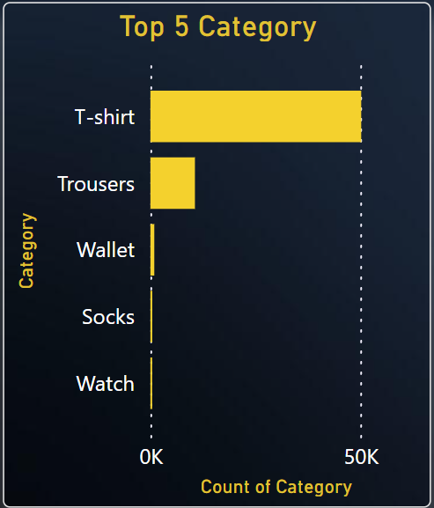
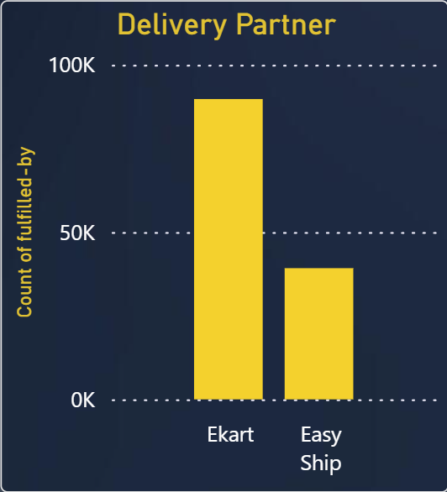
Top 5 Category
Delivery Partner

Slide 7
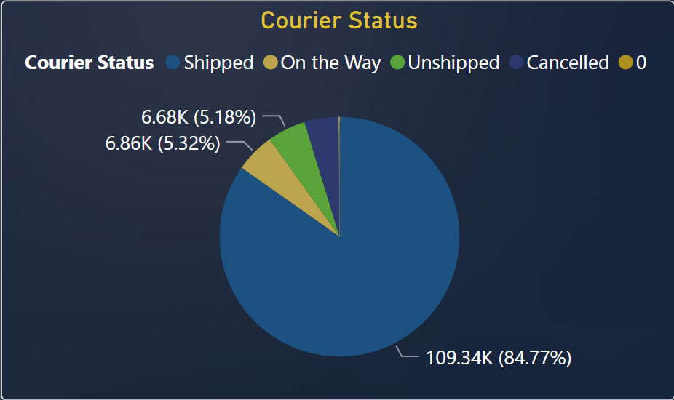
Courier status

Slide 8
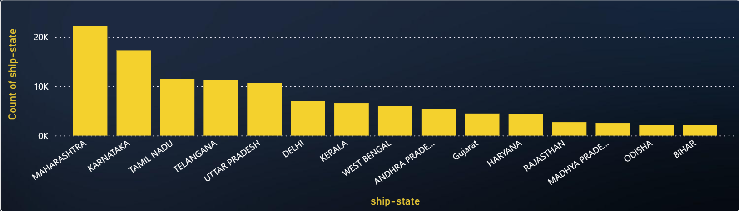
High Sales - State

Slide 9
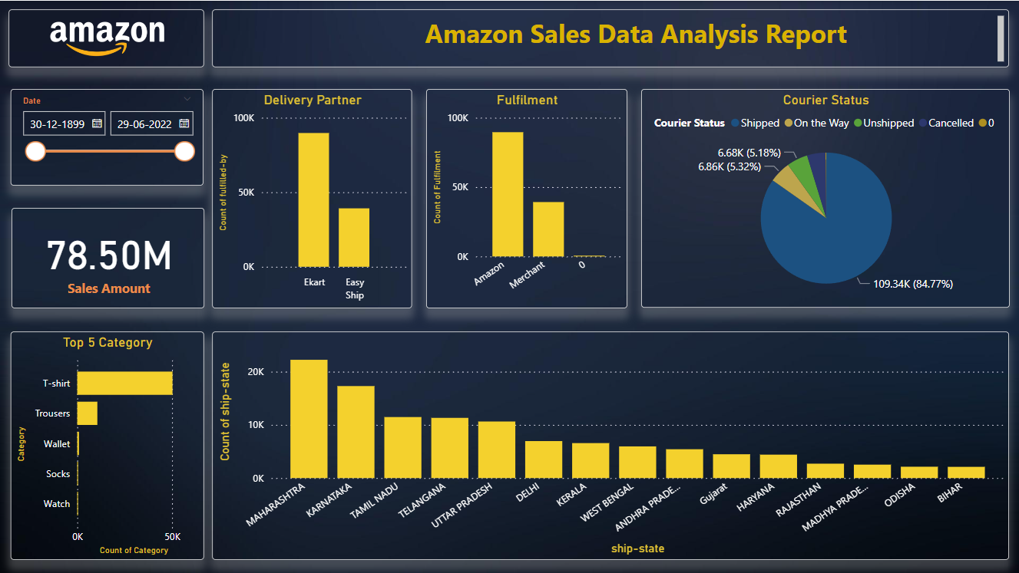

Slide 10
Conclusions
In conclusion, the analysis of Amazon sales data has provided valuable insights into sales trends, product performance, and customer behavior. By leveraging these insights, businesses can make informed decisions to optimize their sales strategies and enhance customer satisfaction.

Slide 11
Thanks!
hariomrajput9099@gmail.com
+91 7796270734

